Slide 1

“Cloud-Based Image Processing”
Mikołaj Leszczuk, Szymon Turek
Notes:
Presenter notes

Slide 2
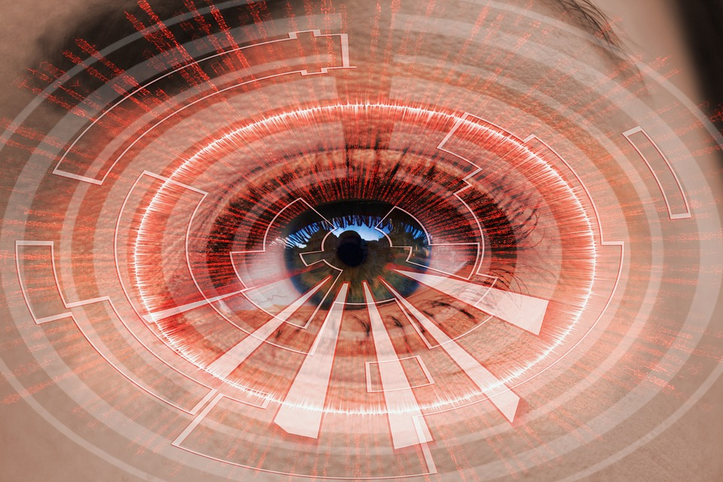
Image Processing (Computer Vision)
Notes:
Image Processing
Any operation done (on digital images) aiming to achieve a certain goal.
Exemplary goals: aesthetics improvement, face recognition, object classification, object tracking and many more…
Computer Vision
A scientific field concerned with how computer can be made to gain high-level understanding from digital images.
Some say it aims to automate tasks the HVS (Human Visual System) can do. Well, it can go (and does go!) beyond that (the example with retina images and gender classification).
In general: it consumes images to make decisions (think about autonomous cars).

Slide 3
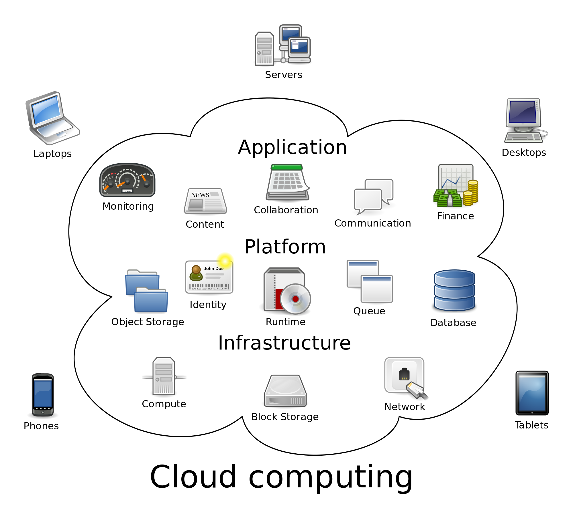
By Sam Johnston - Created by Sam Johnston using OmniGroup's OmniGraffle and Inkscape (includes Computer.svg by Sasa Stefanovic)This vector image was created with Inkscape., CC BY-SA 3.0, https://commons.wikimedia.org/w/index.php?curid=6080417
Notes:
As with many services today, image processing and computer vision also move into cloud environment.
Benefits are similar to those of other applications: you do not need yourself to possess a device with high computational power.
There are some drawbacks, of course. Cloud services inherently have higher delays than local solutions. Can you imagine a Tesla car sending a camera feed to cloud to decide whether to stop before a pedestrian crossing?

Slide 4
Cloud-Based Image Processing
Amazon Rekognition
Microsoft Azure Computer Vision API
Google Cloud API
IBM Watson Visual Recognition
CloudSight AI
Clarifai Computer Vision
Notes:
All the big players are already here

Slide 5
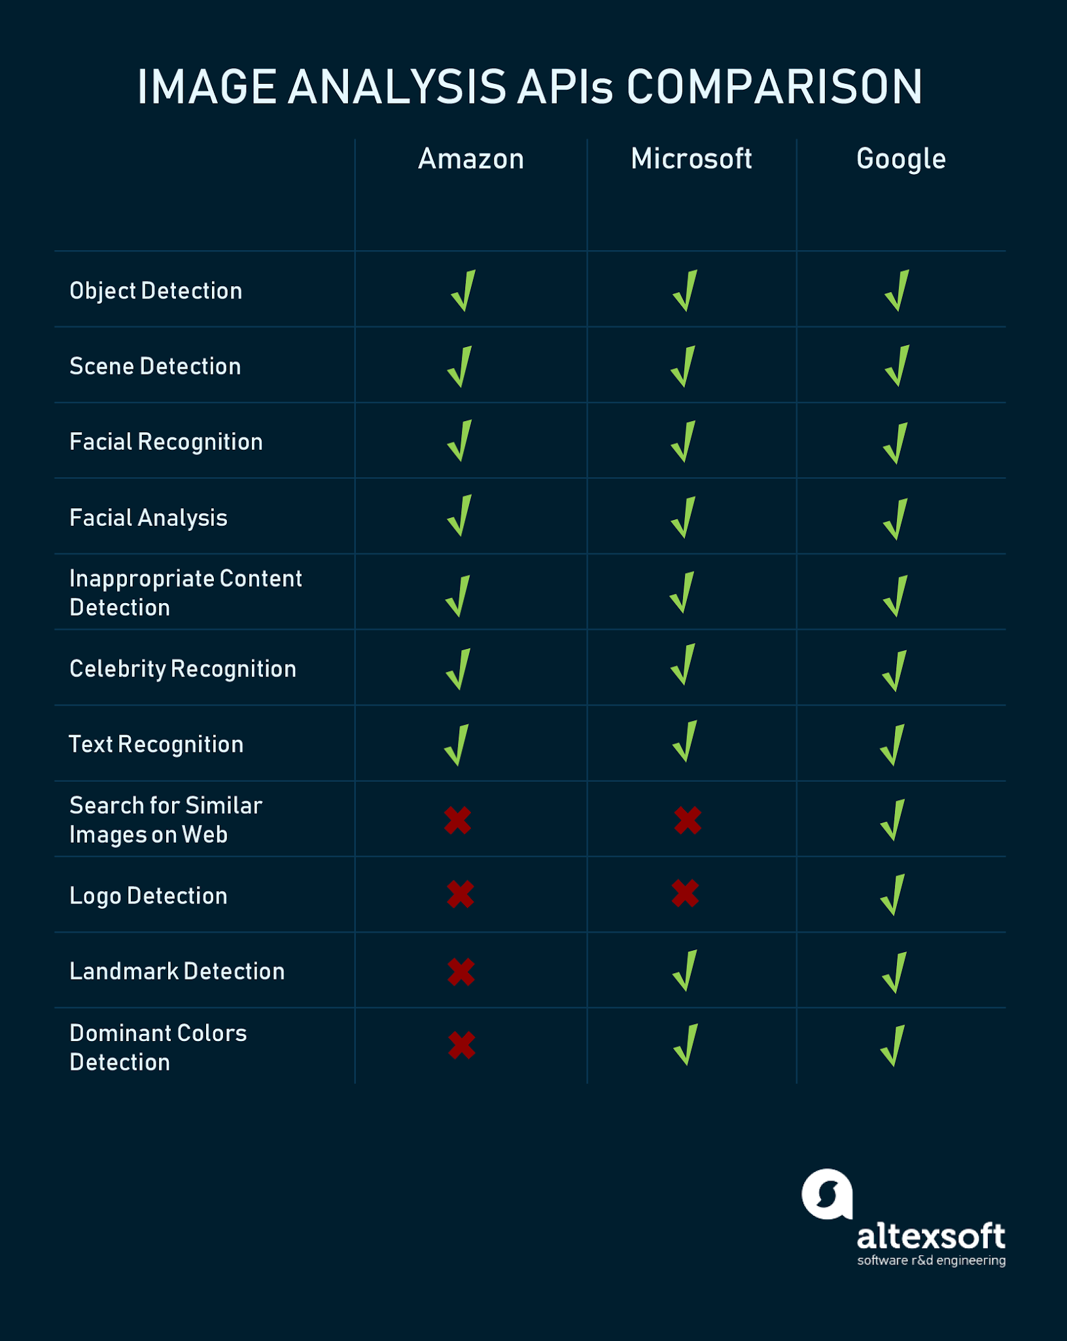
Comparison of possibilities offered by the above tools
Source: https://www.altexsoft.com/blog/datascience/comparing-machine-learning-as-a-service-amazon-microsoft-azure-google-cloud-ai/

Slide 6

Amazon Rekognition
Activity detection
Face searching function
Face-based user verification
License plate verification

Slide 7

Microsoft Azure Computer Vision API
Tagging images
Categorizing images
Identifying image types
Detecting human faces & returning their coordinates
Recognizing domain-specific content
Generating content descriptions
Recognizing handwritten text
Distinguishing color schemes
Cropping photos to be used as thumbnails

Slide 8

Google Cloud API
Label detection

Slide 9

IBM Watson Visual Recognition
Classify virtually any visual content
Analyze images for scenes, objects, faces & other content
Detect faces in image
Custom classifiers:
Created by uploading .zip files containing positive or negative images
Requires at least 2 example .zip files:
2 files with positive images, or
1 with positive & 1 with negative

Slide 10

CloudSight AI
Generating natural language description based on image content
Recognizing fine-grained objects
Classification of images
Scene understanding

Slide 11

Clarifai Computer Vision
Building custom models for client
Image analyzing based on models:
Pre-built models: apparel, celebrity, color, demographics, face detection, landscape quality, etc.
Users also can train their owns models, using simple drag & drop interface based on AI
Model - processing block converting inputs (e.g., images) to predictions (e.g., concepts, bounding boxes, etc.).
Searching by concept & by image

Slide 12

Chosen for exercise
Very simple authentication
Creation of free account not requiring credit card number (notorious procedure for other applications)
Free version of Clarifai allowing to process transactions:
5000 images per month if confirmed e-mail
100 images per month if unconfirmed e-mail

Slide 13
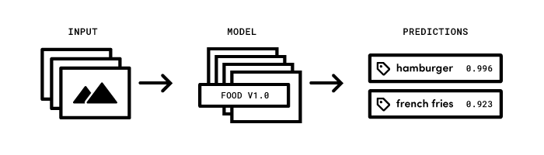
Getting Started
Clarifai API offering image and video recognition as service
Using AI to recognize visual content
API built around simple idea:
Sending inputs (image or video) to service
Receiving predictions

Slide 14
Predict Images via URL
To get predictions for input, need to supply: image and model to get predictions from
Image supply either with publicly accessible URL or by directly sending bytes
Sending up to 128 images in one API call
Notes:
They call it “predict” for marketing purposes… It is actually tagging and object classification

Slide 15
Thank You for Your Attention!
Supplemental exercise
Notes:
Supplemental exercise for 4 points
Give your e-mail address

